Slide 1



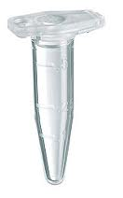
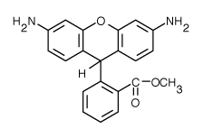
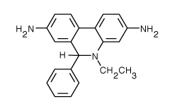
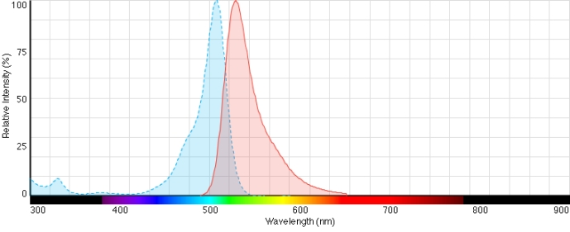
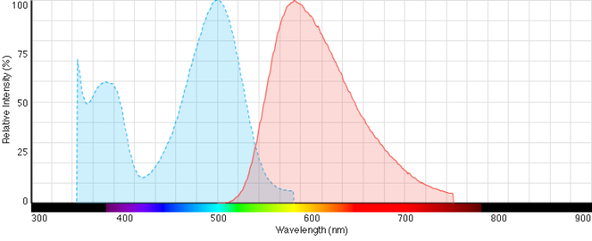
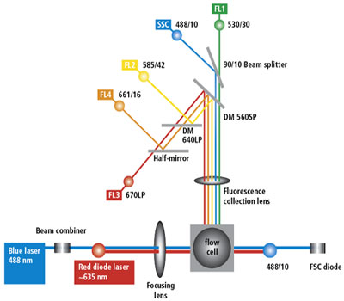
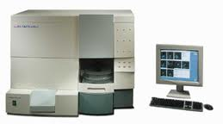
Hydrogen Peroxide Increases the Amount of Intracellular Reactive Species and Decreases Cellular Robustness in Saccharomyces Cerevisiae.
Kayla Moore; Hong Qin
Department of Biology, Spelman College, Atlanta, GA 30314
Abstract
Saccharomyces cerevisiae, also known as the budding yeast, can be used to study the cellular aging process as a model for aging of human cells. Past studies have concluded that there is a strong connection between the presence of superoxides, and cellular aging. This study investigates how the presence of hydrogen peroxide on the outside of the cell influences the amount of hydrogen peroxide inside of the cell. The hydrogen peroxide acts as a stress inhibitor and the cell wants to the keep a balance of between the levels of intercellular and intracellular peroxide by trying to maintain homeostasis. The intracellular levels are detected by dihydroethidium (DHE; red) and d by dihydrorhodamine (DHR; green). DHR and DHE are florescent probes that can be detected by flowcytometry —the use of lasers to detect different aspects between cells. The presence of hydrogen peroxide increases the coefficient variation that represents the DHE and DHR. Those increases represent a growing population of cells due to the induction of heterogeneity. Those increases by caused a decrease in the robustness of the cells
Methods
Results
Ectopic hydrogen peroxide treatment
H₂O₂
0%
0.025%
0.05%
0.75%
0.1%
0.2%
Dihydrorhodamine 123
(DHR)
Dihydroethidium
(DHE)
Introduction
One of the main causes for cellular and physiological aging is the introduction of reactive oxygen species. They are chemical reactive ions that contain oxygen, and in this case H₂O_{2,} hydrogen peroxide, induces the production of reactive ions. Once the yeast cells have been placed in hydrogen peroxide, the cells begin to rapidly produce superoxide hydroxy radicals because they recognize the peroxide as a threat. The overproduction of the radicals creates damage in macromolecules such as proteins, DNA and RNA. DNA and RNA function as the instructions for the production of specific proteins that keep the cell healthy and function properly, but as the instructions are destroyed, the cell begins the age due to its lack of stability. As the cell ages, the probability of developing diseases, such as cancer and Alzheimer’s, increases.
Summary
A scale conversion was used so that the data is shaped in more of bell curve. The introduction of hydrogen peroxide decreases the overall coefficient variation ☹ .
H₂O₂
The strain BY4743 was grown, the cells were restaged, a hydrogen peroxide treatment was performed, a DHR and DHE labeling was performed, then DHR and DHE were both labeled in calibur. Also, DHR was left overnight to see if the results would change, A FACS calibur was used to collect data that was later analyzed using R studio and different other packages provided by bioconductor.com
Materials
Concept of Robustness
Robustness = Ability of cells to maintain homeostasis in the presence of genetic, environmental, and stochastic variations. In this case it’s the presence of H₂O₂
Robustness can be measured by coefficient of variation (CV).
Conclusion
In conclusion, extracellular hydrogen peroxide influences the balance of intracellular hydrogen peroxide and superoxide levels inside the yeast cells. The treatment acts as a stress inhibitor and as the cell goes through more stress the CV increases which means the cell is losing its robustness therefore the cells are aging.
CV = Standard deviation / Mean
Smaller CV
Larger CV
More robust
Less robust
References
1. Martin Weinberger. “Growth signaling promotes Chronological aging in budding yeast by inducing superoxide anions that inhibit quienscence.” AGING 2 (2010): 709-726
2. Qin H, Lu M, Goldfarb DS, 2008 Genomic Instability Is Associated with Natural Life Span Variation in Saccharomycescerevisiae. PLoS ONE 3(7):
Hypothesis
If the yeast cells come in contact with different doses of hydrogen peroxide their oxidative stress will be induced then the cells will age faster.
Acknowledgements
This research was partially supported by Spelman College Research Initiative for Scientific Enhancement (RISE; Grant #2R5GM06566-13), and the Atlanta University Center Career Opportunities in Research Education and Training (NIMH, Grant # MH16573-23).

